Slide 1
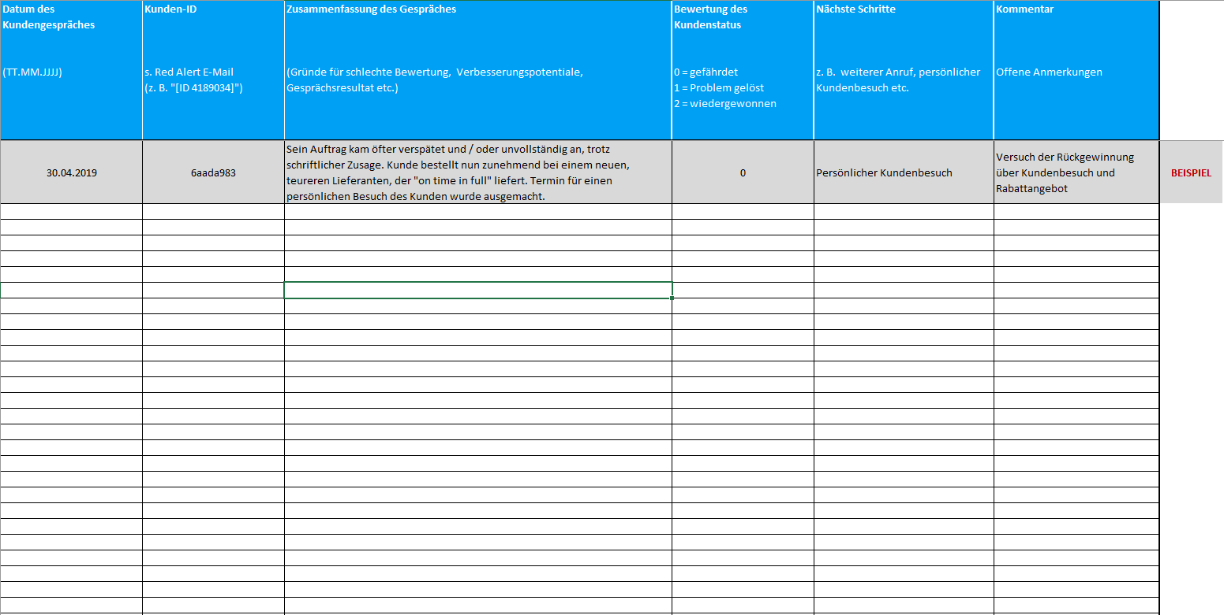
Information about Red Alert definition, process overview and use of Excel templates
Red alert approach – Sales representative information slide
(1) What is a Red Alert?
(3) Relevant questions for customer interview
  How likely is it that you would recommend [our company] to a colleague or business partner? Please answer on a scale from "very unlikely" to "very likely".
What are your reasons for the negative assessment? (NPS question)
Red alerts
How can we keep you as our customer?
…
1
2
3
4
5
6
7
8
9
10
very unlikely
very likely
(4) When to contact different customer groups?
  Cancellation almost a certainty
  Will spread negative opinions to others
!
A / B customer
C / D customer
Red
Alert
(2) Processing of Red Alerts after automated notification
~ 1-2 working days
~ 3-4 working days
1
Preparation of customer interview
Use provided information
(5) How to use the Excel template?
2
Execution of customer interview
Telephone
3
Documentation of customer interview
Excel
  Fill in the columns A to F
  Important: Note that you need to extract the Customer ID from the Red Alert e-mail
  Transfer the Excel file to your local contact person of the customer survey
4
Return the Excel file to local responsible
E-mail

